Slide 1


Create database school

Slide 2
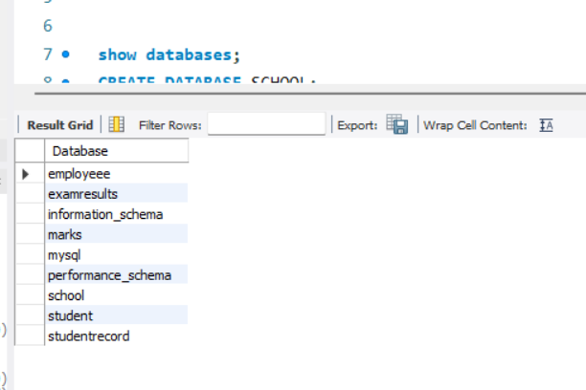
To show databases
Show databases;

Slide 3
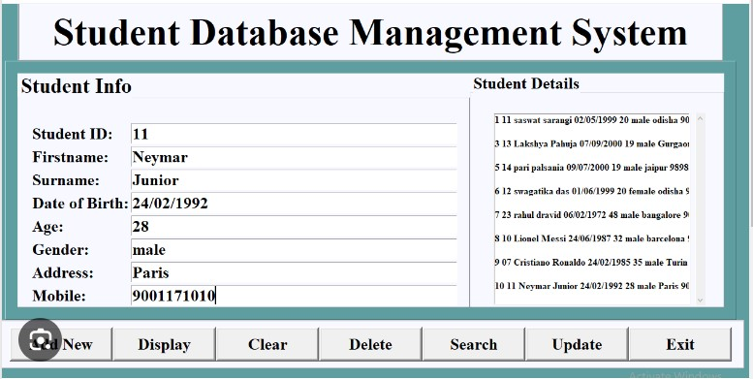

Slide 4
Database --------------------------- school
Tables --------------------------- student details, student record
Student details contains student _ id, first _ name, surname, date of birth,
Age, gender, address, mobile.
Student record contains student _ id, first _ name, surname, course code,
Maths, English, biology, chemistry.

Slide 5
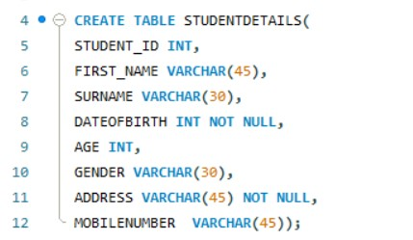
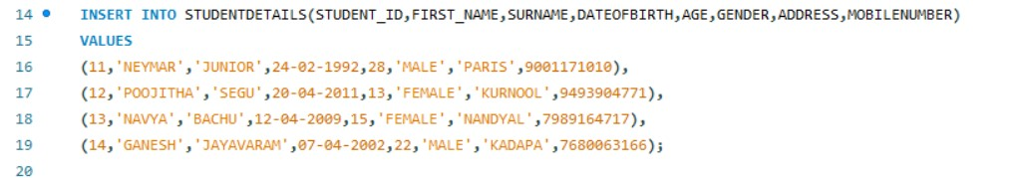
STUDENT DETAILS
Student details table
Inserting the data

Slide 6
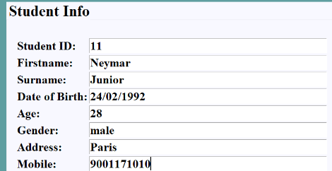
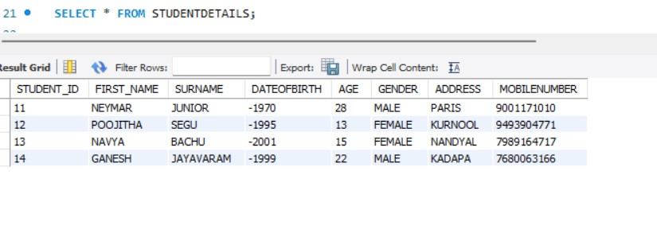
To display student details
To view student details
Select * from student details;

Slide 7
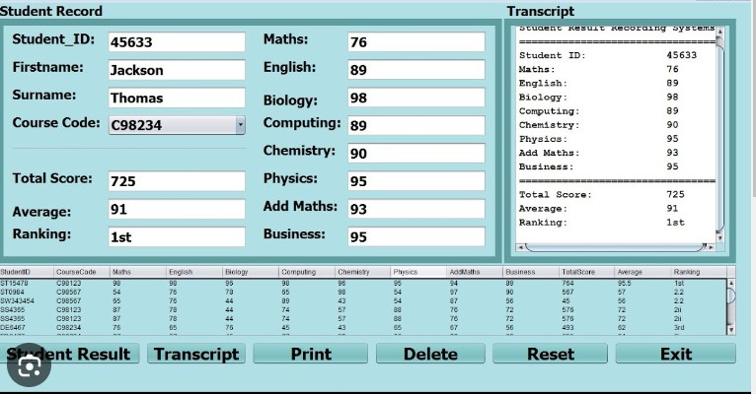

Slide 8
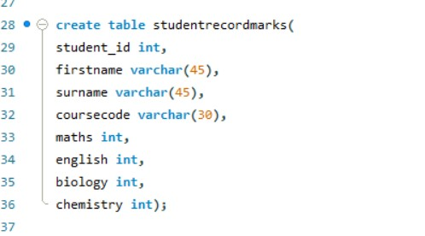
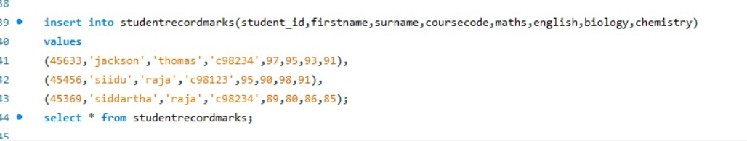
Student records
Student marks table
Inserting the data

Slide 9
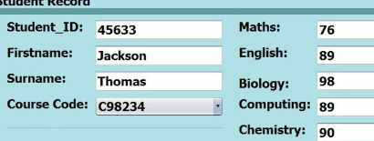
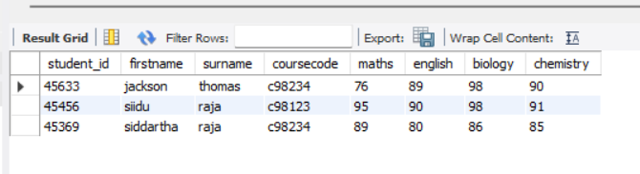
To display student marks
To view student record marks
Select * from student record marks;

Slide 10
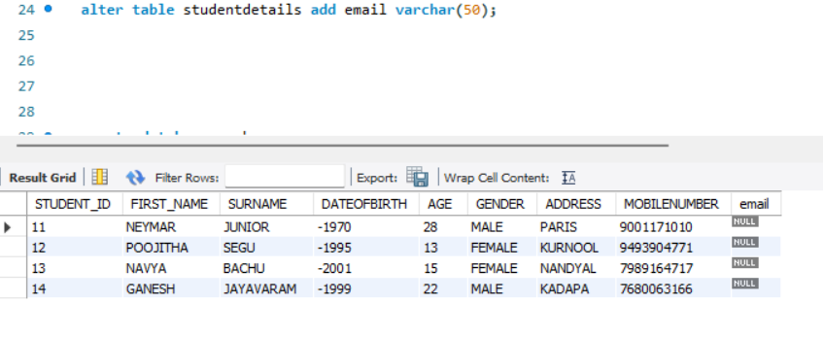
To add new column
Alter table student details add email varchar(50);

Slide 11
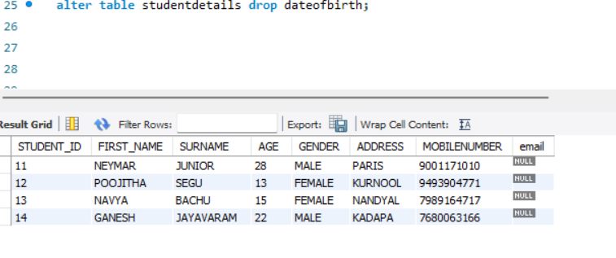
To drop column
Alter table student details drop date of birth;

Slide 12
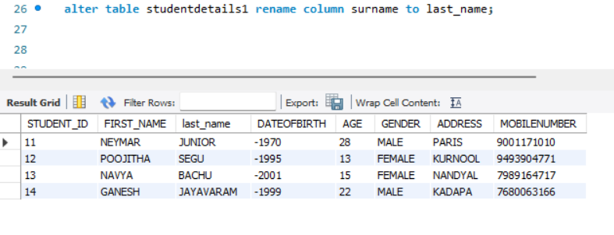
To rename column name
Alter table studentdetails1 rename column surname to last_name

Slide 13
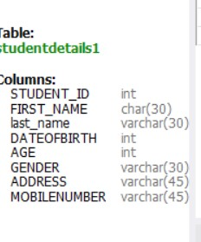
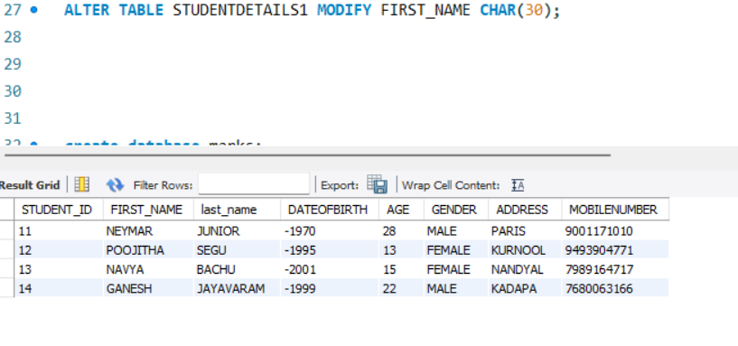
To modify data type
Alter table student details modify first _ name char(30);

Slide 14
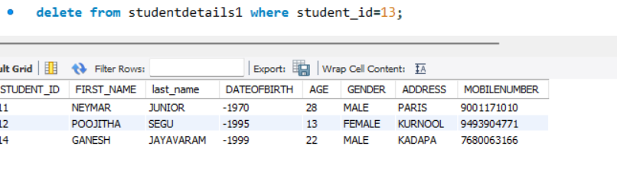
To delete a total row
Delete from studentdetails1 where student _ id=13;

Slide 15
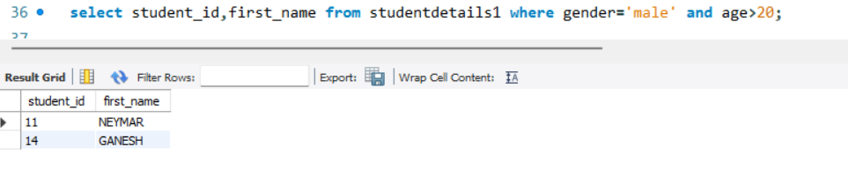
Using where clause
Select student _ id, first _ name from stuidentdetails1 where gender =‘male’ and age>20;

Slide 16
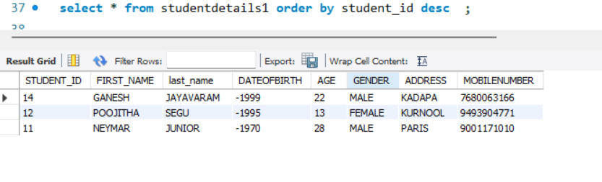
Using order by
Select * from studentdetials1 order by student _ id desc;

Slide 17
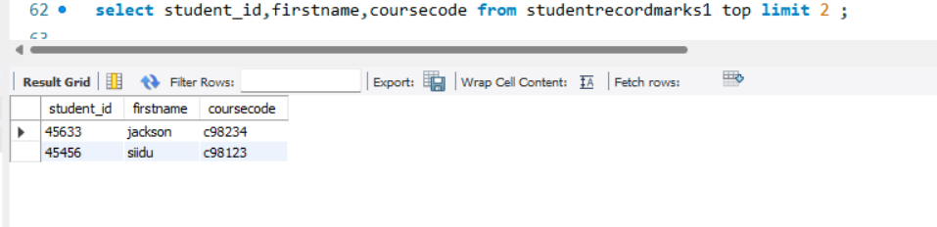
Using top clause
Select student _ id, first name, course code from studentrecordmarks1 top limit 2;

Slide 18

Software used
My SQL

